Slide 1
CAN YOU DESIGN THE FUTURE ?

Slide 2
Innovation by FAZEL PAVAND

Slide 3
Compact and high efficiency car rooftop concentration photovoltaic for electric vehicle and other places we need energy.

Slide 4
I simply name it ANGEL

Slide 6
Why I innovated ANGEL
Using solar energy to charge an electric car is not a new idea.
A lot of plug-in vehicle drivers have been doing it for several year. It's a smart energy strategy, but the initial investment was substantial.
My idea is to do without a large rack of solar panels which people fit on their roof or in their garden.
The only solar panels used here are on the car's roof

Slide 7
The only problem is that there's only 1.5 square meter of solar cells on the car's roof. That's definitely not enough to power a car.
Car manufacturers have already considered at the subject—most notably, Toyota for its Prius, and all German carmakers for their most expensive sedans. They offer the option of a solar panel built into the roof, but it's only for cooling the car when parked under the sun.
Still good, but more is needed

Slide 8
So I developed ANGEL fitted with a Fresnel lens on its top with robotic arms, to direct sunlight to the solar cells of the car parked below
That's impressive and critically it's enough to fully charge the battery of all kind of EV with zero emission driving, all courtesy of the sun.
Increased wear on the cells efficiency may be an issue, and so is heat / for avoid extra heating I use anti IR and UV coated especial lens I simply using a IR filter on a lens

Slide 9
The bass solar cells is SunPower’s X21 solar cells.
On 1.5 square meters, for a power capacity of 300-350 watts in normal sun and 2.5 KW/H
In concentrated suns / and dual axes sun-tracking technology that together allow for more electricity generation from the Highly efficient X21 SunPower’s solar cell. By using renewable power, ANGEL Concept is estimated to reduce the annual greenhouse gas emissions (GHG) from a typical owner by 10 metric tons.”

Slide 10
Access to EV Charging Stations is an important requirement for a growing number of drivers.
The need for regular charging forces electric vehicle drivers to seek-out and park in locations equipped with charging stations.
With electric vehicle usage on the rise, loyalty.

Slide 11
Electric vehicles are the way of the future
There are 196 country in the world and just few of this country have Charging Station for EV /and in this country with EV Charging Station / 90% of this Station located inside the big city's only /and in other word if you drive with your EV to out of the city you most leave your car there and return home by bus / this is the biggest problem of electric vehicle /but if you have an ANGEL on your car rooftop you should not be bothered moor.

Slide 12
ANGEL save annually 900 $ cost of gasoline / 400 $ cost of electric for each vehicle and give independent to driver from the grid

Slide 13
Electricity Costs for Charging
The fuel efficiency of an all-electric vehicle may be measured in kilowatt-hours (kWh) per 100 miles rather than miles per gallon.
To calculate the cost per mile of an all-electric vehicle, the cost of electricity (in dollars per kWh) and the efficiency of the vehicle (how much electricity is used to travel 100 miles) must be known. If electricity costs $0.11 per kWh and the vehicle consumes 34 kWh to travel 100 miles, the cost per mile is about $0.04.

Slide 14
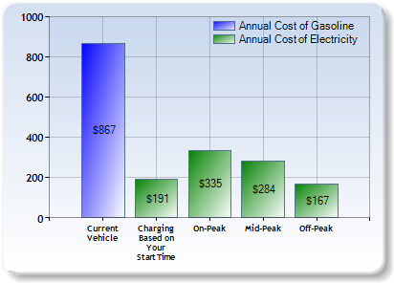
If electricity costs $0.11 per kilowatt-hour, charging an all-electric vehicle with a 70-mile range (assuming a fully depleted 24 kWh battery) will cost about $2.64 to reach a full charge.

Slide 15
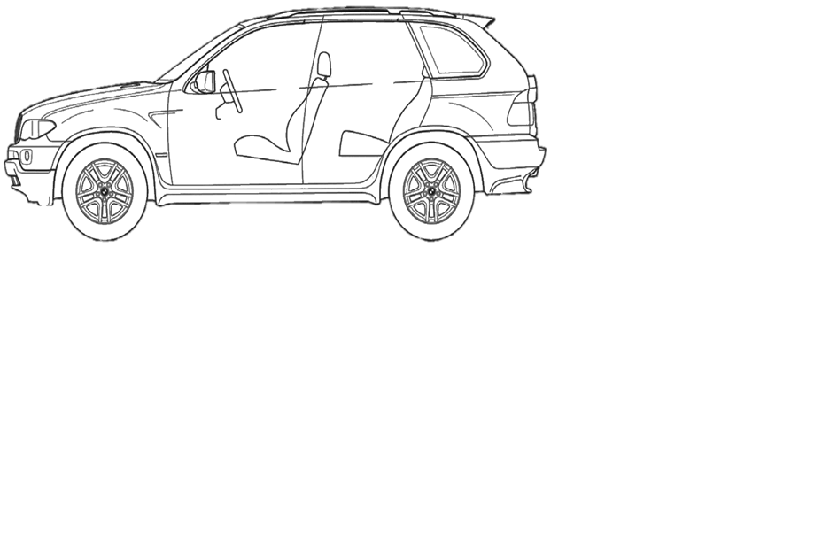
How ANGEL works

Slide 16
The system is ready to be powered.
Installation is rather simple and the steps are comparable to installing a car rooftop cargo box.
ANGEL Mounted on the vehicle roof and .start working with normal sun

Slide 17
How ANGEL works
1- After completely stopping the car / driver send START command by cellphone or remote controller.
2- ANGEL control the received command by its GPS .to detect that car was not moving
3- ANGEL control the time of the day (to detect day or night time) to start its working.
4- ANGEL control wind pressure / and shadow detector sensor / to detect normal wind and sunny position for working.

Slide 18
5- ANGEL start work and robot arm 1 comes out automatically
6- Arm 2 comes out electrically.
7- Air pump Fresnel lens comes out automatically.
8- Air pump Fresnel lens expended to its final position.
9- GPS Sun tracking system automatically give sun position to ANGEL computer control unit and control unit give command to DC motor / for positioning the
system in right direction.

Slide 19
ANGEL APP.
1- Send and receive (start / Stop) command.
2- Provide necessary information abut the system performance.
3- Collect best Sunny position GPS data and give advises to driver for best parking position.
4- Provide daily / monthly / yearly energy production by system.
5- Provide daily / monthly / yearly Information abut reducing the annual greenhouse gas emissions (GHG) by this system.

Slide 20
6- Automatically Start system in specified GPS direction ( park place for home and work place that we know there is no problem to Start automatically for the system).
7- Provide all this data to ANGEL had office to analyze the data for improving the system and sharing benefits of ANGEL with the world.

Slide 21
The purpose for the ANGEL is
to charge the car’s batteries with solar power. That way, the owner wouldn’t necessarily need an electrical
outlet to plug in.
52 mi or 83 km
Drive with Solar power per day.

Slide 22
The purpose for the ANGEL is to charge the car’s batteries with solar power
For example with 14 hour between sunrise and sunset in Dubai for May / you can see in the fallowing table / and with 2 Kw/H output of ANGEL in one hour charging time and with estimate 10 hours working time period instead of 14 Hours
ANGEL electricity output must be 20 KW in normal day. And its enough for day long trips.
.

Slide 23
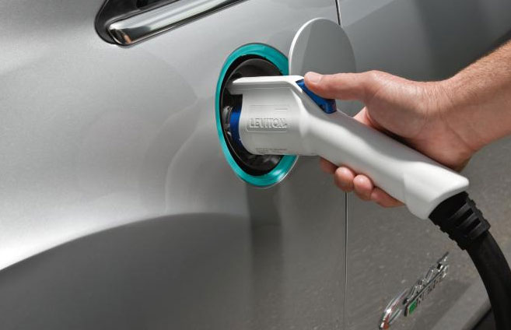
EV passenger car will go 52 electric miles with this amount of energy.
That may not seem like a lot, but most trips for most drivers are quick trips to work or the grocery store.
I estimates that the electric range could cover 95 percent of all trips made by an average driver.
STOP

Slide 24
Sunrise and sunset in Dubai in May and length of day.
 |  |  | Length of day |  | Solar noon
Date | Sunrise | Sunset | This day | Difference | Time | Altitude | Distance
 |  |  |  |  |  |  | (million mi)
May 16, 2014 | 5:34 AM | 6:57 PM | 13h 23m 11s | + 1m 01s | 12:15 PM | 83.8° | 93.984
May 17, 2014 | 5:33 AM | 6:57 PM | 13h 24m 11s | + 59s | 12:15 PM | 84.1° | 94.003
May 18, 2014 | 5:33 AM | 6:58 PM | 13h 25m 10s | + 58s | 12:15 PM | 84.3° | 94.023
May 19, 2014 | 5:32 AM | 6:58 PM | 13h 26m 07s | + 57s | 12:15 PM | 84.5° | 94.043
May 20, 2014 | 5:32 AM | 6:59 PM | 13h 27m 03s | + 56s | 12:15 PM | 84.7° | 94.062
May 21, 2014 | 5:32 AM | 6:59 PM | 13h 27m 58s | + 54s | 12:15 PM | 84.9° | 94.081
May 22, 2014 | 5:31 AM | 7:00 PM | 13h 28m 51s | + 53s | 12:15 PM | 85.1° | 94.099

Slide 25
How Angel robot arms works

Slide 26
Step 1
Angel
Mounted on the vehicle roof and start working with
normal sun

Slide 27
Attention
Robot arm
didn’t work in driving positioning and it work when car completely stop and weather condition is normal.

Slide 28
Step 2
Angel
Robot arm
1 comes out electrically

Slide 29
Step 3
Angel
Robot arm
1 extended electrically

Slide 30
Step 4
Angel
Fresnel lens comes out pneumatically

Slide 31
Step 5
Angel
Under concentrated
8*suns
begins to produce electricity with high efficiency
Angel
Fresnel lens comes out pneumatically and Expansion

Slide 32
Step 6
Angel
Under concentrated
8*suns
begins to produce electricity with high efficiency

Slide 34
How ANGEL dual axis tracker robot arm s rotated for daily tracking

Slide 35
Step 1
Angel
Under concentrated
8*suns
begins to produce electricity with high efficiency

Slide 36
Step 2
Angel
Under concentrated
8*suns
begins to produce electricity with high efficiency

Slide 37
Step 3
Angel
Under concentrated
8*suns
begins to produce electricity with high efficiency

Slide 38
Step 4

Slide 39
Step 5

Slide 40
SunPower Maxeon® solar cells
The ANGEL Tracker combines Dual-axis tracking technology with Air pump Fresnel lens, reflecting light onto high performing SunPower Maxeon® solar cells, with an efficiency of 22.8 percent.
The 2-killowatt ANGEL system will require only 300 kilowatts of SunPower solar cells when corresponding to a geometric concentration ratio of seven to one and a power-based ratio of six to one.

Slide 41
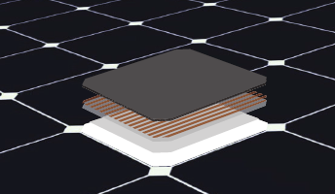
SunPower® Signature™ Black X-Series

Slide 42
Angel top view
long arm packed into considerably smaller "package",
140 cm
ROBOT ARM

Slide 43
Angel dimension
3 M
1.6 M
35 cm
Weight : 35 KG
1.4 M

Slide 45
Innovation in innovation

Slide 46
Air pump Fresnel lens
Anti IR & UV

Slide 47
The ANGEL follows the sun over the day to collect its light. Specially designed optical lenses capture and concentrate the optimal amount of sunlight into the Sunpower cell.
ANGEL track the sun over the full day, using every hour of sun. Only the visual part of the light spectrum is transported - IR and UV radiation are filtered out.
That means that much of the heat energy in the solar radiation is blocked and we did not have heat in car rooftop and the harm materials like UV radiation also.

Slide 48
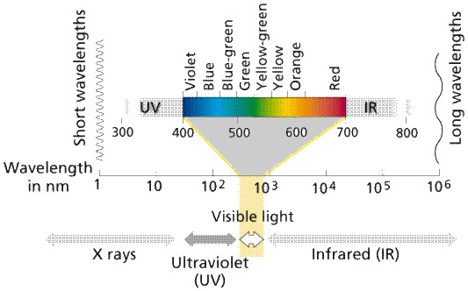
The IR and UV wavelengths are stripped out before the visible light is sent into the cell.

Slide 49
Howe Air pump
Fresnel lens
Anti IR & UV work
and what is the benefit of it?

Slide 50
Fresnel lens automatically came out by air pressure and expended.
Especial polymer PMMA material give 20* inflatable .capacity to the lens
Benefit of this method
.1- Compact
2- light weight.
.3- Self cleaning
.4- Fast opening and closing
5- No need for any mechanical part to support the lens.
6- Shock absorber.
7- Easy changeable.

Slide 51
Step 1
Step 2
Step 3
Step 4

Slide 52
ANGEL
CHALLENG AS BREAKTHROUGH TECHNOLOGY IDEA
FOR SUSTAINABILITY
AND ENVIRONMENTALITY

Slide 53
In 1894, the Times of London estimated that by 1950 every street in the city would be buried nine feet deep in horse manure. One New York prognosticator of the 1890s concluded that by 1930 the horse droppings would rise to Manhattan’s third-story Windows
And In 2012, for the first time in history, over 60 million cars passenger cars will be produced in a single year (or 165,000 new cars produced every day
Today, some environmental activists (and European Union) would have us believe the only sensible response to climate concerns is to narrow (rather than expand) the public’s transportation options.)..

Slide 54
Without such measures they say, the worst will happen. But these people have no more insight into what the future holds than the commentators who were certain the streets would be nine feet deep in manure by 1950.
We often hear that climate change is accelerating, that everything is worse than we thought. The truth of these statements is highly debatable. What seems far more clear-cut is that the pace of technological innovation is accelerating. New ideas come to market faster than ever before. The time it takes for life-changing technologies to be adopted by the general public grows ever shorter

Slide 55
This means we have more reason than those who inhabited the smelly cities of the late 1800s to expect that technology will solve some of our biggest challenges. This applies whether we believe climate change is a serious threat or not. To quote the Super freak comics authors:
When the solution to a given problem doesn’t lay right before our eyes, it is easy to assume that no solution exists. But history has shown again and again that such assumptions are wrong.

Slide 56
This is not to say the world is perfect. Nor that all progress is always good…But humankind has a great capacity for finding technological solutions to seemingly intractable problems, and this will likely be the case for global warming and energy. It isn’t that the problem isn’t potentially large. It’s just that human ingenuity – when given proper incentives – is bound to be larger. Even more encouraging, technological fixes are often far simpler, and therefore cheaper, than the doomsayers could have imagined In other words, the future is bright. And there’s good reason to believe it contains less – not more – horse manure

Slide 57
Electric Vehicles
Electric mobility will make an important contribution towards ensuring sustainable mobility and meeting the environmental demands of the
future.
Electric vehicles come in all shapes and sizes, and as a group should be called 'Electrically Chargeable Vehicles' (ECVs)..

Slide 58
Most stakeholders assume a realistic market share for new electrically chargeable vehicles to be in the range of 2 to 8% by 2020 to 2025, based on today’s market.
This depends on how quickly some of the immediate challenges beyond the automobile industry's control can be addressed, such as the provision of electric vehicle infrastructure and support by utility providers and governments.
If these challenges can be overcome, consumer acceptance of these new vehicle types could accelerate their wider adoption

Slide 59
ANGEL
produce
Green Power

Slide 60
What Is Green Power?
Green Power is electricity generated wholly or in part from renewable energy sources, such as wind and solar power, geothermal, hydropower, and various forms of biomass
What Are The Benefits?
Green power lowers our dependence on foreign oil. It also generates less pollution than conventional power and produces no net increase in GHG emissions, helping protect human health and the environment.

Slide 62
And one more thing….

Slide 63
ANGEL Mobile posts in regions hit with disasters.

Slide 64
ENGINEERED FOR ENDURANCE
These all aluminum and stainless steel construction trailers are designed from by us to be durable on any road or sever weather condition.
Its lightweight suspension is perfect for long travels or dirt roads. Internal electronics are protected in a shock resistant weather sealed cabinet.
The optional environmental temperature control package allows the trailer to work in blazing hot or freezing temperatures anywhere on the planet.

Slide 65
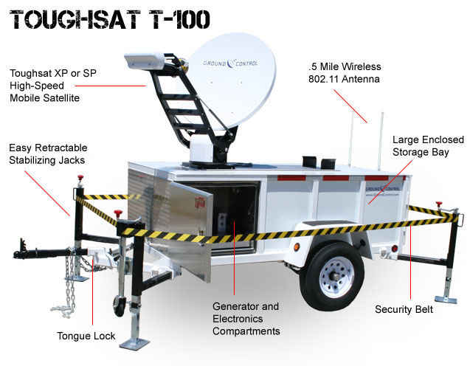

Slide 66
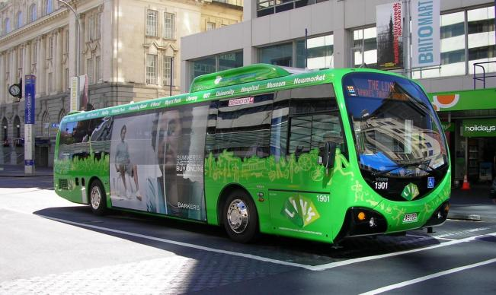
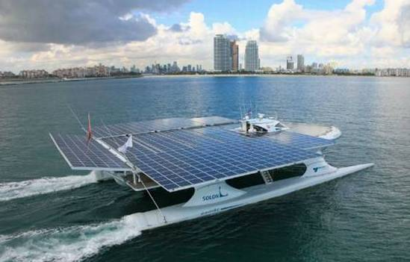
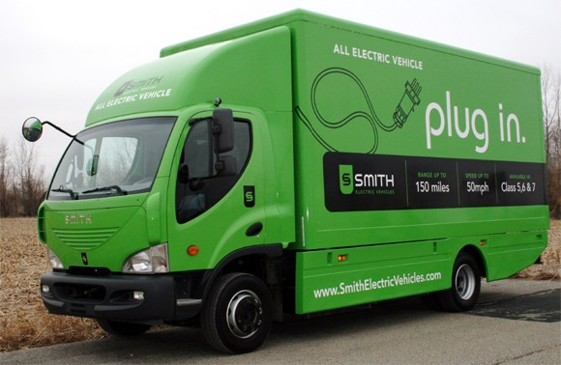
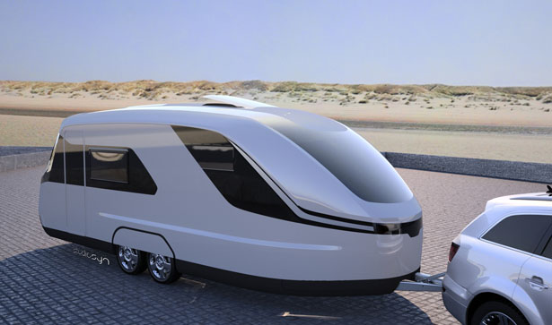
Where else can this system be used?
Electric bus
Solar and electric boat
Electric camion
Caravan

Slide 67
THANK YOU

